Slide 1


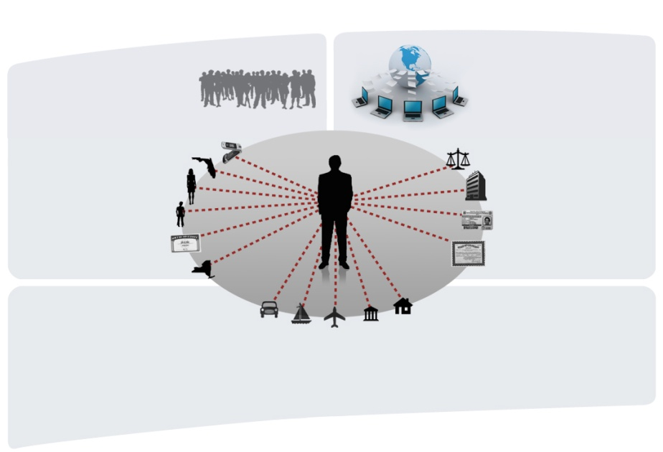


Tony Middleton, Ph.D., Sr. Architect, Data Scientist
Data Science Track
1:30 Wednesday 02/29/2012

Slide 2
The “Big Data” Challenge
One of the most complex tasks in data processing is record linking…
  The data integration process of accurately matching or clustering records containing information which refer to the same entity such as a person or business.
  “Big Data” limits the capability of organizations to process and use their data effectively and makes the record linkage process even more challenging.
  New high-performance data-intensive computing architectures such as Hadoop MapReduce and HPCC allow processing of “Big Data” and can solve complex data processing problems including record linkage
  SALT (Scalable Automated Linking Technology) is new tool which automatically generates code in the ECL language for the open source HPCC platform based on a simple specification to address most common data integration tasks including data profiling, data cleansing, data ingest, and record linkage.
  SALT can dramatically reduce development time, complexity, and lines of code to implement data integration processes which will be shown by an actual case study.
44 Lines of SALT
3,980 Lines of ECL
482,410 Lines of C++

Slide 3




At LexisNexis, Linking is essential to the Data Integration Process
Data
Linking
Analytics
Public record and proprietary data on consumers and businesses
Advanced technology which matches and links files across disparate data sources
Unique and proven analytic tools
for all types of data
ƒ^{x}(x,y) = (x-y)²
HPCC (Open Source High-Performance
Computing Cluster)
Data integration needs scalable processing power to allow for complex matching, scoring and clustering of Big Data

Slide 4
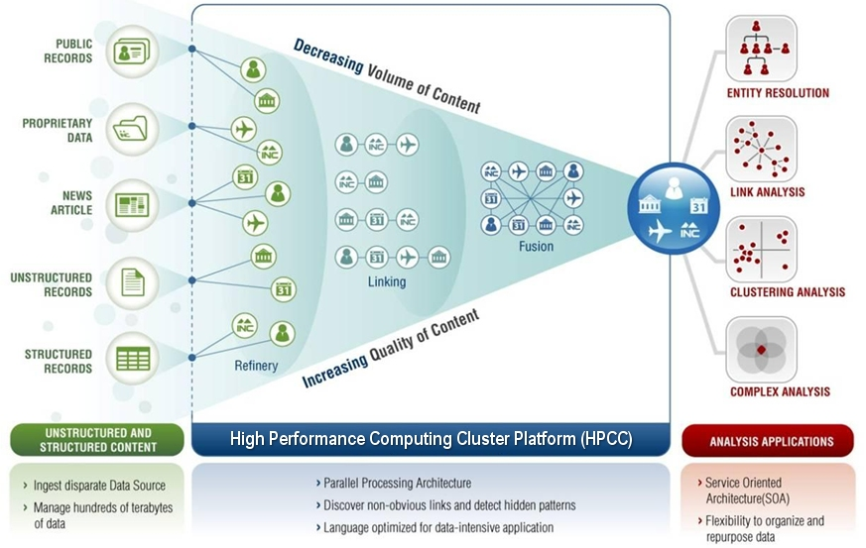
Open Source HPCC is designed for Big Data Integration
Cyber Security
Financial Services
Government
Health Care
Big
Data
Insurance
Online Reservations
Retail
Telecommunications
Transportation & Logistics
Weblog Analysis
INDUSTRY SOLUTIONS
Customer Data Integration
Data Fusion
Fraud Detection and Prevention
Know Your Customer
Master Data Management
Weblog Analysis
Open Source Components
High Performance Computing Cluster Platform (HPCC) enables data integration on a scalable, cost-effective platform designed for Big Data
HPCC provides a single unified architecture with two primary data platforms (Thor and Roxie) which combine to create a complete data processing and query solution, using a common programming language (ECL) for both platforms.
ECL is a declarative, data-centric programming language optimized for data-intensive computing applications and high-performance parallel architectures

Slide 5
HPCC runs on Commodity Computing Clusters
Thor
Roxie
Scalable, parallel batch processing engine for ETL applications
An alternative to Hadoop for
Big Data processing
Multiple Thor clusters are allowed in an HPCC system environment, and job queues can span multiple clusters
Each Thor cluster has its own local file system, but Thor clusters can read information from other clusters in a multiple cluster environment
Thor distributed file system is logical record oriented, records can be distributed by a Thor job in any manner, logical records are not split across nodes
Uses ECL programming language
High-performance, low-latency, multi-user,
structured query and analysis processing for online applications
Functions as a data warehouse and fast query processing engine providing a unified processing environment with Thor
Supports thousands of simultaneous queries and users with sub-second response time
Uses a special distributed indexed file system to provide parallel processing of queries
High-Availability, tolerant of node failures with automatic recovery
Uses ECL programming language

Slide 6
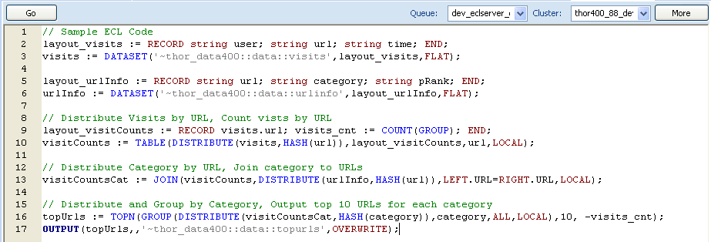
Enterprise Control Language (ECL)
ECL is a declarative, data-centric, programming language which can expressed concisely, parallelizes naturally, is free from side effects, and results in highly-optimized executable code.
ECL is designed for a specific problem domain (data-intensive computing) which makes resulting programs clearer, more compact, and more expressive. ECL provides a more natural way to think about data processing problems for large distributed datasets.
Since ECL is declarative, execution is not determined by the order of the language statements, but from the sequence of dataflows and transformations represented by the language statements. The ECL compiler determines the optimum execution strategy and graph.
ECL incorporates transparent and implicit parallelism regardless of the size of the computing cluster and reduces the complexity of parallel programming increasing the productivity of application developers.
The ECL compiler generates highly optimized C++ for execution.
ECL provides a comprehensive IDE and programming tools.
ECL is provided with a large library of efficient modules to handle common data manipulation tasks.
Notes:
6
6

Slide 7
Addressing the “Big Data” Integration Challenge
SALT – An ECL Code Generation Tool
SALT (Scalable Automated Linking Technology) is new tool which automatically generates code in the ECL language for the open source HPCC platform based on a simple specification to address most common data integration tasks including data profiling, data cleansing, data parsing and classification, data ingest, and record linkage.
SALT incorporates some of the most advanced technology and best practices of LexisNexis Risk Solutions. LexisNexis currently has 30 patents pending related to record linkage and other technology included in SALT.
SALT includes innovative new approaches to approximate string matching (a.k.a. fuzzy matching), automated calculation of matching weights and thresholds, automated selection of blocking criteria, automated calculation of best values for fields in an entity, propagation of field values in entities to increase likelihood of matching, automated calculation of secondary relationships between entities, automated splitting of entity clusters to remove bad links, automated cleansing of data to improve match quality, and automated generation of batch and online applications for entity resolution and search applications.

Slide 8
Data Integration Process Model
Data Preparation Processes
Profiling: Data profiling is a step usually performed by data analysts on raw input data to determine the characteristics of the data including type, statistical , and pattern information as well as field population counts. The goal of profiling is to fully understand the characteristics of the data and identify any bad data or validity issues and any additional cleansing, filtering, or de-duplication that may be needed before the data is processed further .
Parsing: Raw input data files may need additional parsing as part of the ETL process to create the individual fields to be use for matching in the record linkage process.
Cleansing: Also called data hygiene, is the process of cleaning the raw input data so that it can be used effectively in a subsequent process like record linkage. The cleanliness of data is determined by whether or not a data item is valid within the constraints specified for a particular field
Normalization: Normalization is required when multiple source data files are utilized in a record linkage process. Each source file may contain information about the entity to be linked, but the files may have different formats and varying content. The purpose of normalization is to extract the data that will be used for matching from each individual source file, and map this data into a common layout or uniform presentation.
Standardization: Standardization of certain types of input data (like names and addresses) is essential to achieving high-quality results in a record linkage process. Data can be represented differently in different sources or be incomplete. Data in any field can be missing or have erroneous values.

Slide 9
Data Integration Process Model
Record Linkage Processes
Matching Weights and Threshold Computation: Calculating the match probabilities and weights of individual fields used in the matching process as well as the threshold value for a record match.
Additional Data Ingest: merging of additional standardized input data source files with an existing base file or with each other to create the base file on which the record linkage process will be performed. If a linked base or authority already file exists, the data ingest process functions as an update and merges the new or updated record information into the base file
Blocking/Searching: In an exhaustive search for all possible record matches in the input data, each record must be compared to every other record in the data, an n² process. Blocking keys to access or join the data are defined based on the match criteria to partition the database into mutually exclusive blocks or subsets of data to subdivide the file to increase the number of matches found while decreasing the number of pairs of records which have to be examined
Weight Assignment and Record Comparison: Using blocking criteria, data is accessed from the source data file to be linked with the blocking keys using joins or other methods, and each record in the block is compared to the other records in the block, by comparing the values of individual fields defined as part of the linking criteria for equality or similarity. Each field is assigned a matching weight based on the quality of the match which may be scaled when using fuzzy matching techniques if not an exact match.
Record Match Decision: The record match decision is made using the total score computed from matching two records and aggregating individual field match scores, compared to a pre-computed threshold value.

Slide 10
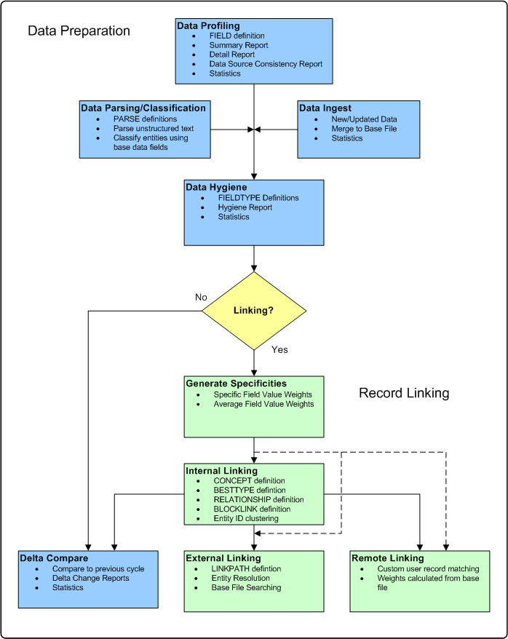
SALT Data Integration Process
The SALT data integration process flow follows the general data integration process model with data preparation steps and record linking steps.
A SALT process typically begins with data profiling to support data analysis on data sources. Other data preparation steps can include parsing/classification of unstructured data, data ingest to merge source data for linking, and data hygiene to determine data which should be cleansed. Data preparation can also include a delta file compare to identify changes in the data.
SALT linking processes include generation of specificities or matching weights for the linking process, followed by the specific linking process.
SALT internal linking is the basic clustering process where records in a base or authority file containing information about entities are matched to identify which records are associated with which entity.
SALT external linking allows an external file of records or an online query to be matched to an existing base or authority file to determine which entity is matched. Also called entity resolution.
SALT remote linking allows SALT specificities and matching to be incorporated into a custom user record matching application.

Slide 11
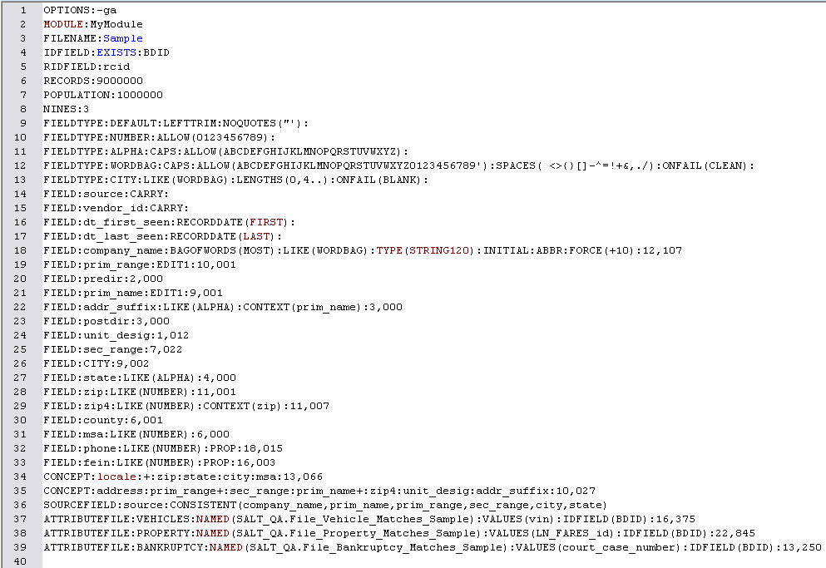
SALT Basic Concepts
SALT is an executable program coded in C++ which can be executed from a Windows or Linux command prompt or directly from the ECL IDE development tool in the HPCC environment.
The SALT program reads as its input a text file containing user-defined specification statements, and produces an output file containing the generated ECL code to import into the user ECL code repository.
The specification file is a text file with declarative language statements and parameters that define the data file and fields to be processed, and associated processing options such as the module into which the generated code is imported.
Although the primary use of SALT is for record linkage and clustering applications, SALT offers auxiliary capabilities including data profiling, data hygiene, data source consistency monitoring, data ingest and updating of base data files, and file comparison to determine delta changes between versions of a data file.
SALT encapsulates a significant amount of ECL programming knowledge, experience, and best practices gained at LexisNexis for the types of applications supported, and can result in large increases in developer productivity. It also offers a significant reduction in implementation time and cost over a hand-coded approach.
SALT can be used with any type of data in any format supported by the ECL programming language to create new applications, or to enhance existing applications

Slide 12
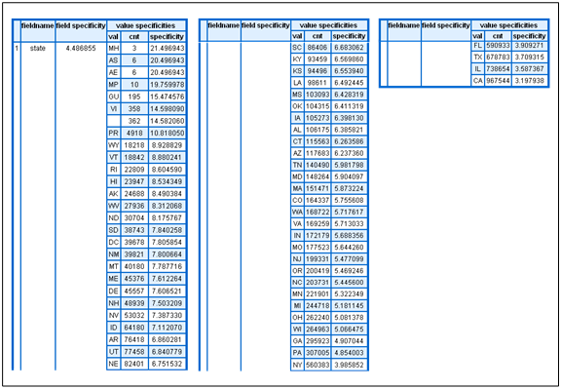
SALT Field Weight Computation and Record Matching
SALT calculates record matching field weights based the concept of term specificity and matching weights are referred to within SALT as specificities.
SALT applies the concept of term specificity to the unique field values for a field defined for a record in the input dataset(s) to be matched to calculate a field value specificity for each unique value contained in the field across all records in the dataset. The rarer a field value is in the input dataset, the higher the specificity value.
SALT uses the field value specificities as weights for determining record matches in a record linking/clustering process.
SALT compares each field in the two records for similarity based on the definition of the field in the SALT specification file. If the field values match between the two records, the specificity for the field value (scaled for fuzzy matches and otherwise adjusted based on the editing options for the field) is added to a total specificity to help determine a record match
Each field defined in the specification file for the record can make a positive, negative, or no contribution to the total specificity
SALT automatically calculates a total specificity matching threshold for determining a record match based on the specification file definition which includes the target precision.

Slide 13
SALT Specification Language
MODULE: Specifies a module name (folder) in the ECL repository (directory) where the source code generated by SALT will reside
FILENAME: Allows a logical name for the input file to be specified and processed by the code generated by SALT. The name parameter identifies ECL attributes which define the input dataset and the input record layout for the process
PROCESS: Specifies an overall name for an external linking or remote linking process
IDFIELD: Identifies the field to be used as the entity ID for record linkage
RIDFIELD: Name of the numeric field containing the record identifier or RID. Each record in the input dataset should have a unique RID value. The entity cluster ID for each matched set of records will be the lowest value RID in the group at the end of the record linkage process.
RECORDS: Specifies the expected number of records at the end of a record linkage process.
POPULATION: specifies the expected number of entities at the end of a record linkage process. When the matching process is complete, entity clusters or records are formed, each identified by a unique entity ID
NINES: Specifies the precision required for a SALT generated record linkage process. The precision is expressed as a number of nines such that a value of 2 means 3 nines or 99.9%.
FIELDTYPE: Allows field editing and validity checking requirements used for data hygiene processing to be defined and grouped into common definitions which can then be associated with any field. An ONFAIL parameter allows the user to select what occurs when an editing constraint is violated. A CUSTOM parameter allows a user-defined ECL function to be referenced to perform validity checking. The PARSE parameter allows parsing to be defined which can utilize a user-coded ECL PATTERN or automatically generate a PATTERN.
BESTTYPE: Defines a best value computation for a FIELD or CONCEPT for a given basis for an entity. The calculated best value can be used for propagation during record linkage, and is available for external application use.
FIELD: Defines a data field in the input file record including its type and other characteristics which affect hygiene, validity, and matching. Parameters define fuzzy matching such as edit distance or phonetic. A BAGOFWORDS parameter allows the field to be treated as a sequence of space delimited tokens which allows matching to occur with no order dependency of word tokens and using the specificity of the individual words contained in the field as weights for matching.

Slide 14
SALT Specification Language
FUZZY: Specifies a custom user-supplied fuzzy matching ECL function for a FIELD. SALT automatically handles other requirements such as scaling of the field value specificity
DATEFIELD: Specifies a numeric string field in the format YYYYMMDD . It functions in an identical manner to the FIELD statement except for requiring the specific date format and includes special fuzzy matching options.
SOURCEFIELD: specifies the name of the field containing the input data source type. Used for data source consistency checking and as group by field for statistics. In combination with SOURCERIDFIELD, identifies record in source file for data.
SOURCERIDFIELD: specifies the name of a field in the input file which contains a unique identifier for a corresponding record in the source file which has been merged into the base file.
LATLONG: specifies a geo-point field for the location associated with a record based on latitude and longitude fields included in the specification file. The population density of entities in the grid defined by the DISTANCE and DIVISIONS parameters for the grid around all geo-points is calculated giving the field match score for a given distance from a geo-point.
CONCEPT: Allows a group of related or dependent fields to be defined and is used so that dependent fields are not over weighted in the record linkage process when the fields only really have meaning in the context of other fields.
ATTRIBUTEFILE: Defines a special type of field which provides a set of values for matching from an external file or child dataset which is part of the main input file. During the matching process, if attribute values match between records being compared, the match will contribute to the overall score of the record match.
INGESTFILE: Specifies an ingest file to be appended/merged with the base file as part of a SALT record linkage process.
LINKPATH: Specifies the name of a search path for an external linking entity resolution process generated by SALT.
RELATIONSHIP: Allows SALT to determine if an additional statistically significant link exists between the two clusters using a specific basis and to record this relationship for external use.
THRESHOLD: Overrides the default record matching threshold calculated by the SALT code generation process.

Slide 15
SALT Specification Language
BLOCKTHRESHOLD: Overrides the default block threshold which is the minimum specificity allowed for a collection of blocking fields
EFFICACY: Allows user control of which matching rules are included in an internal linking process. Some matching rules may generate very few matches, the performance of an internal linking process can sometimes be significantly improved by eliminating ineffective matching rules.
RANGEFIELD: Defines two paired source fields which contain the low value and high value for the date range to be checked in each record during matching.
CLEAVE: Allows clusters with two distinct centers of mass to be split using a specified basis. The concept is that in such a there will be one or more planes upon which it is possible to split the cluster without records spanning the plane.

Slide 16
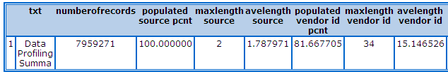
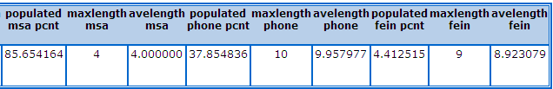
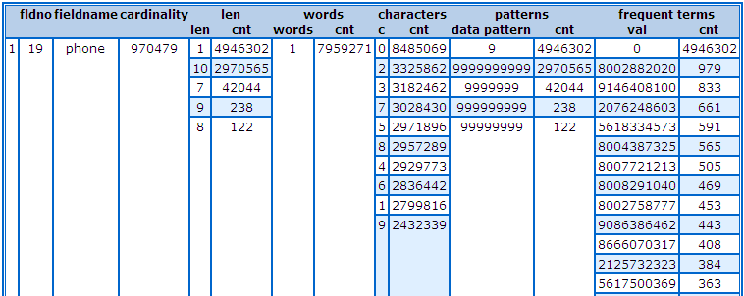
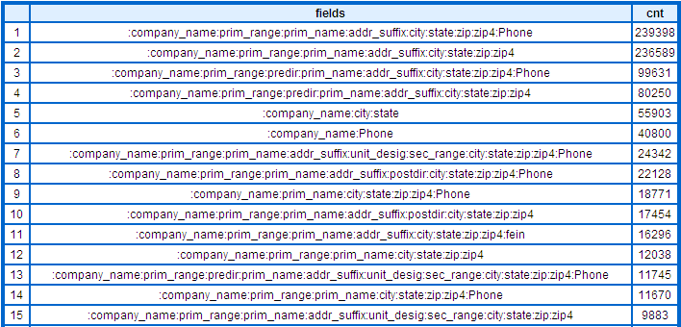
SALT Data Profiling
Data profiling provides important type, statistical, and pattern information on the data fields and concepts and their contents in any input data file.
Essential in analyzing the content and shape (patterns) of the data in the source data files and facilitates important decisions concerning data quality, cleansing, de-duping, and linking of records, and to provide information on the changing characteristics of data over time.
Usually performed by data analysts as exploratory data analysis, and is an important preparatory step for the record linkage process. Can be used by non-ECL programmers.
The data profiling summary provides basic info such as the number of records in the input file, the percentage of non-blank data, maximum field length, and average field length.
The data profiling detail report provides field by field breakdowns of all the characters, string lengths, field cardinality top data values, and word counts for every data field or concept defined. The top data patterns are also displayed to help analyze the shape of the data.
The field combination analysis shows the top combinations of fields which are non-blank sorted by frequency.

Slide 17

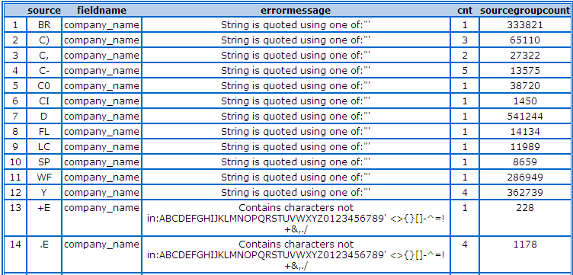
SALT Data Hygiene
SALT uses the term data hygiene to refer to both the cleanliness of the data and the process by which data is cleansed so that it can be used effectively in a subsequent data integration process such as record linkage.
Cleanliness of data is determined by whether or not a data item is valid within the constraints specified for a particular data field. By default, no error checking will occur unless specified for field definitions in the specification file.
SALT uses the FIELDTYPE statement to support most common types of validity checks on data in fields. Custom user-defined functions which perform user-specific validity checks can also be included with the CUSTOM option.
SALT data hygiene can be used as an independent process to check the input data, and if appropriate, the user can correct any problems identified to create a cleansed input file before continuing with other SALT processes like record linkage.
SALT can also automatically cleanse bad data before proceeding in which is controlled by the ONFAIL parameter of the FIELDTYPE statement.
The DEFAULT fieldtype applies to all fields unless overridden, and the LIKE parameter allows fieldtypes to be nested in a hierarchical manner.

Slide 18
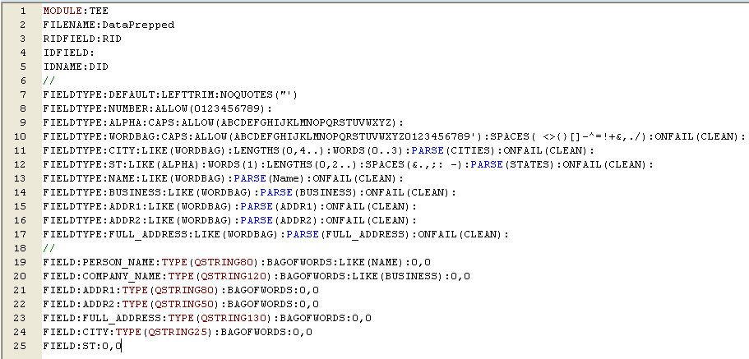
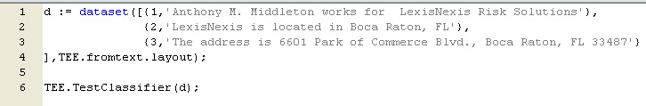
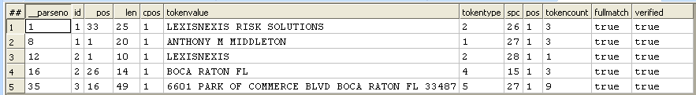
SALT Data Parsing and Classification
SALT includes the capability to parse and optionally classify any text stream based on user-specified parse patterns and a base file of input data.
ECL includes powerful NLP capability including a PARSE statement and a PATTERN statement which can be used to create custom BNF grammars.
The PARSE parameter on the SALT FIELDTYPE statement can be used to specify user-defined ECL parse patterns or to trigger SALT to automatically generate a parse pattern according the characteristics of the FIELDTYPE.
Parsing, or parsing and classification is generated as a separate SALT application which can be used in the data preparation process for record linking or as part of any information extraction and classification application.

Slide 19
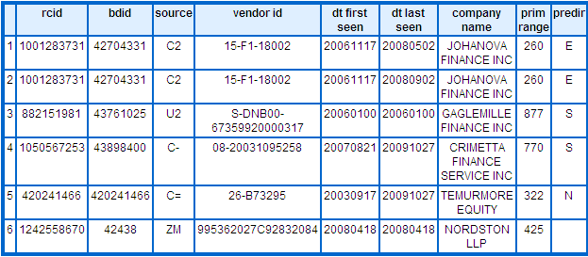
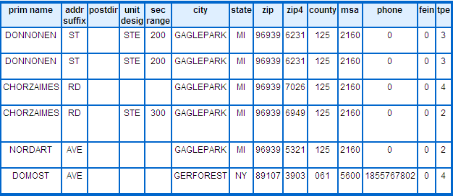
SALT Data Ingest
Data processing applications which maintain a base or authority file with information on an entity typically require periodic updates with new or updated information. The reading and processing of new information to add or update the base file is usually referred to as a data ingest process.
The SALT data ingest process applies the ingest records to the base file and determines which records are: new, never seen before; updates, identical record to an existing record in the base file but with newer record dates; unchanged, identical to an existing record in the base file but not altering a record date; and old, records exist in the base file but not in the ingest file.
Three reports are produced by the data ingest process in addition to the updated base file:
  Statistics by ingest change type and source defined by the SOURCEFIELD statement with record counts where type indicates old, new, updated, or unchanged;
  Field change statistics between old and new records as defined by the unique id defined by the SOURCERIDFIELD statement (vendor_id for the sample data example shown below) match between old and new records;
  Record counts by ingest file source defined by the SOURCEFIELD statement.
SALT can generate code which will automatically perform data ingest operations as an independent process, or as part of and combined with an internal record linking process.

Slide 20
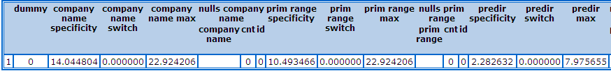
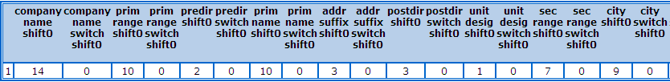
SALT Generating Specificities
The first step in running a SALT record linking process is to generate the field value and average field specificities that will be used as weights for matching during the linking process.
Once specificities have been calculated the average field specificity and switch values can be added to the specification file. This information allows SALT to generate optimized code and set various thresholds appropriately for the record linkage processes.
SALT produces a specificities report which shows an average field specificity value, maximum specificity value, and switch value for each FIELD, CONCEPT, and ATTRIBUTEFILE statement in the specification file. In addition, SALT shows which values if any for each field will also be treated as nulls (other than blanks and zeros) by SALT in the matching process.
The field value specificities are stored in either persisted data files or index/key files depending on the generation mode selected. Persisted files are an HPCC and ECL feature that allow datasets generated by ECL code to be stored, and if a process is run again, and the code or other data affecting the persisted file has not changed, it will not be recomputed.

Slide 21
SALT Internal Linking
The goal of the internal linking process is SALT is to match records containing data about a specific entity type in an input file and to assign a unique identifier to records in the file which refer to the same entity.
Internal linking can also be thought of as clustering, so that records referring to the same entity are grouped into clusters, with each cluster having a unique identifier.
SALT uses the field value specificities as weights for determining record matches in the internal linking process. SALT will compare each field, concept, and attribute file in the two records for similarity. If the values match between the two records, the specificity for the value (scaled for fuzzy matches and otherwise adjusted based on the editing options for the field) will be added to a total specificity to help determine a record match.
Each field can make a positive, negative, or no contribution to the total specificity. If the total specificity exceeds the pre-determined matching threshold, then the two records are considered a match.
SALT generates entity links (a) if they are above the calculated threshold (either the default or user-specified); and (b) are the highest scoring linkage for both records involved in the link.

Slide 22
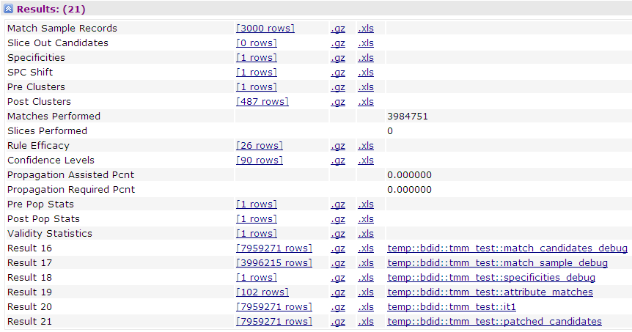
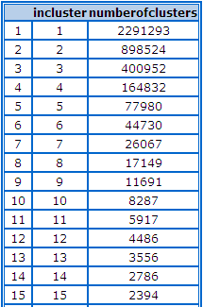
SALT Internal Linking
The internal linking process is iterative beginning with the input base file and any additional ingest files which are merged with the input base file, with each processing iteration attempting additional matches of records to records and entity clusters formed in the previous iteration.
As new entity clusters are formed or expanded during each iteration, more information becomes available about an entity. In a successive iteration, this may allow additional records or entire clusters to be merged with an existing cluster.
Multiple iterations are usually required for convergence and to achieve high levels of precision and recall for a given population of entities. A typical SALT-generated record linkage system will be iterated quite extensively initially, but may only need additional iterations once or twice a month as new or updated data is ingested.
The results from each iteration should be reviewed to determine if the record matching results have met precision and recall goals or if under-matching or over-matching has occurred. Adjustments may need to be made to the specification file.
If the goals of the linking process have been met, the result of final iteration becomes the new linked base file.

Slide 23
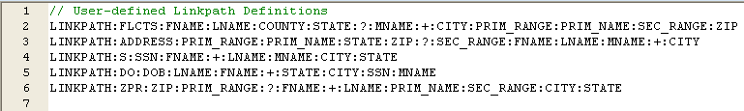
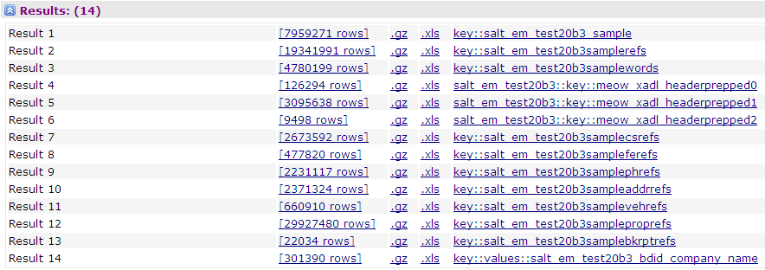
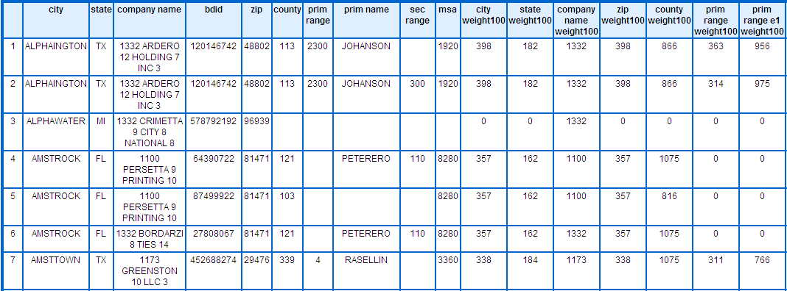
SALT External Linking
The goal of the external linking process of SALT is to match records containing data about a specific entity type in an external file or online query to a previously linked base file of entities and to assign a unique entity identifier to records in the external file or to the query which refer to the same entity.
External linking is also useful in establishing foreign key relationships between an external file and an existing file based on the unique entity id.
External linking can also be thought of as entity resolution, so that records or online queries containing information about an entity are resolved by matching the records to a specific entity in an authority file, and assigning the corresponding unique entity identifier,
The external linking capability requires a previously linked input file in which all the records have been clustered for a specific entity type. The linked input file is used to build keys required for external matching.
SALT LINKPATH statement swill result in the creation of an ECL Index (key) file which is used in the external matching process.
SALT also automatically creates an additional key called the UBER key using all the fields and concepts defined in your specification file.

Slide 24
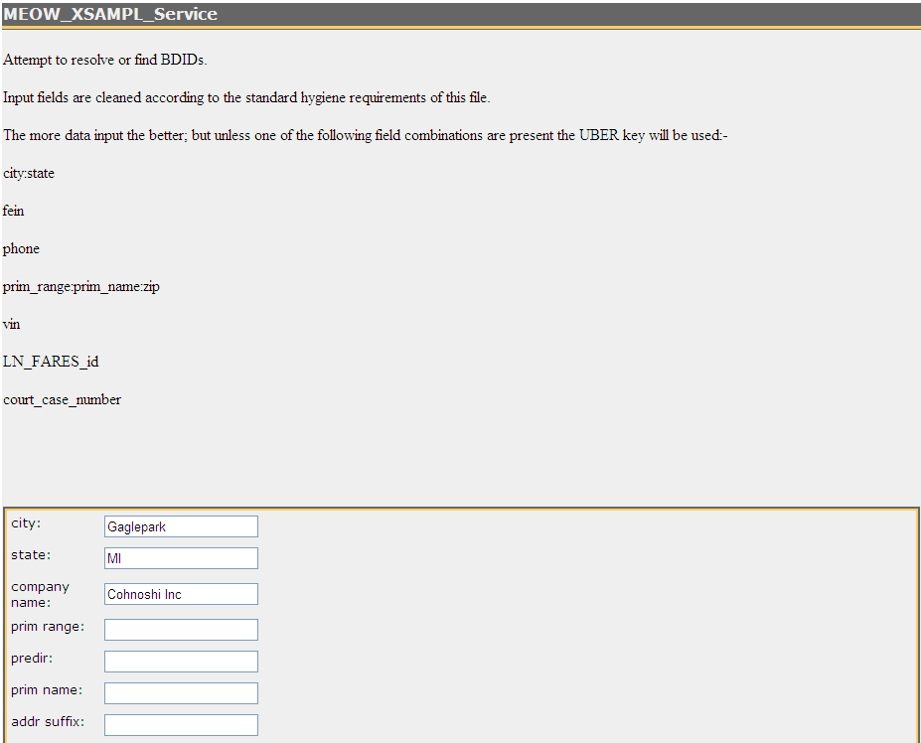
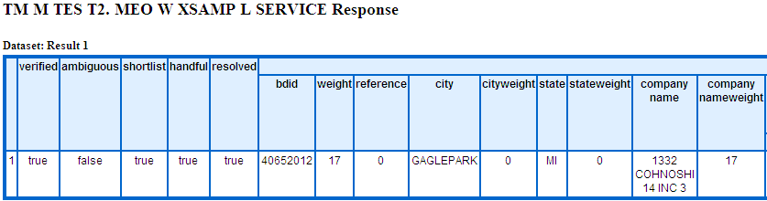
SALT External Linking and Advanced Searching
SALT external linking automatically generates two deployable Roxie services to aid in debugging the external linking process which also can be used for manual examination of data to evaluate linkpaths, as well as to support the online mode external linking capability.
SALT provides an additional query which displays all the entity records from the internal base file matching the input information. This query is useful in debugging the external linking process to assess how a particular record was resolved or not resolved to an entity. This service also provides a base file search capability that can be incorporated into other HPCC online applications.
The base file search is intended to return records organized with the records which best match the search criteria first. Depending on the search criteria, the SALT will use the defined LINKPATHs and the UBER key to perform the search.
An UBER key search can work with many multiple fields. You can search, for example, for someone with two different last names who has lived in two different counties.
The UBER key can be used as the fallback for an external linking application and entity resolution, or it can be used independently to provide an advanced searching capability

Slide 25
SALT Case Study: Insurance Data Link
44 Lines of SALT
3,980 Lines of ECL
LexisNexis Risk Solutions Insurance Services used SALT to link all available insurance data and existing person data to create an insurance header file (iHeader) and insurance data link identifier (IDL).
Process combines 1.5 billion insurance records and 9 billion person records. 290 million core clusters are produced by the linking process.
Reduced source lines of code from 20,000+ to 44
Reduced linking time from 9 days to 55 hours.
Precision of 99.9907 achieved
482,410 Lines of C++

Slide 26
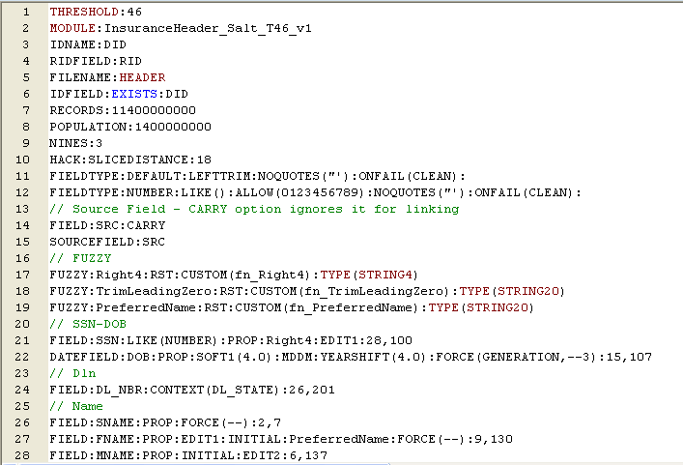
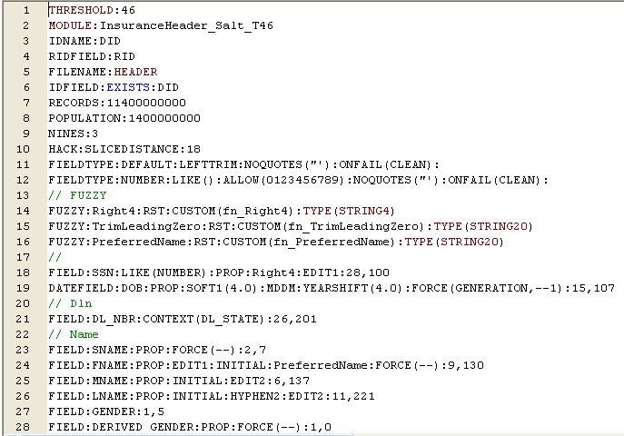
SALT Case Study: Insurance Data Link SALT Specification

Slide 27
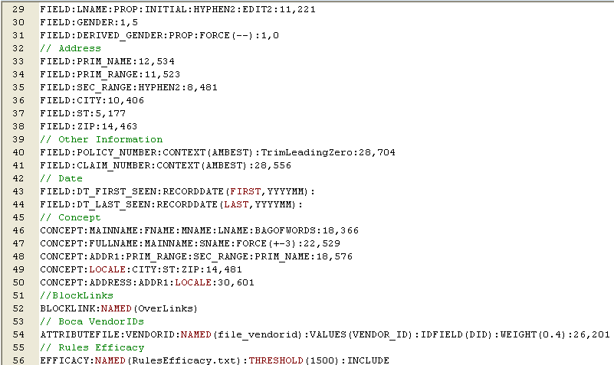
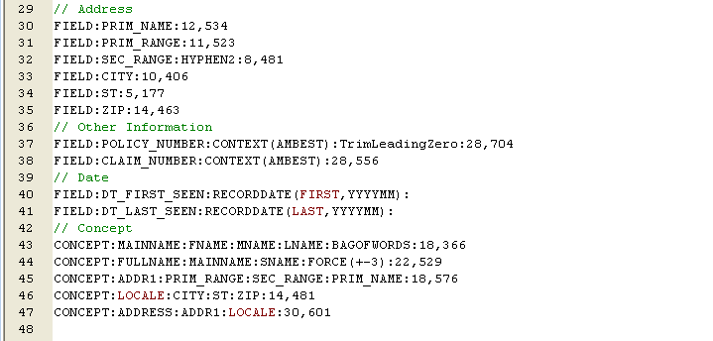
SALT Case Study: Insurance Data Link SALT Specification

Slide 28
SALT Summary and Benefits
Data integration and data analysis are fundamental data processing requirements for organizations. One of the most complex and challenging data integration applications is record linkage, especially with Big Data.
The record linkage process is used by organizations in many types of applications ranging from maintaining customer files for customer relationship management, to merging of all types of data into a data warehouse for data analysis, to fraud detection
SALT can automatically generate executable code for the open source HPCC platform in the ECL language for common data integration applications. SALT applications are defined using a simple, declarative specification language edited in a standard text file, significantly enhancing programmer productivity for data integration applications.
SALT includes important data preparation applications including data profiling, data parsing and classification, and data hygiene which can significantly reduce bugs related to data cleanliness and consistency.
SALT provides record linking applications to support clustering of data referring to the same entity, entity resolution of external data to a base or authority file, and advanced searching capabilities to find data related to an entity, and generates code for both batch and online access.
SALT automatically generates field matching weights from all the available data, and calculates default matching thresholds and blocking criteria for record linking applications.
SALT record linking applications are data neutral and support any data type available in the ECL programming language, support both real-world and abstract entity types, can provide higher precision and recall than hand-coded approaches.
SALT handles relationships and dependencies between individual fields, supports definition of non-obvious relationships between entity clusters, allows definition and propagation of best values for a field in an entity cluster to improve matching, provides many built-in fuzzy matching capabilities, and allows users to define custom fuzzy-matching functions using the FUZZY statement.
SALT incorporates many patent-pending innovations to enhance all aspects the record linkage process including new approaches to approximate string matching (BAGOFWORDS).

Slide 29
SALT Additional Info
SALT is available as an additional-cost module (binary only) with the HPCC Systems Enterprise Edition.
Download a copy of the SALT User’s Guide from the http://hpccsystems.com site
  http://hpccsystems.com/salt
  Username: salt Password: hpccsalt@strata
The just-published by Springer “Handbook of Data-Intensive Computing” includes a chapter “SALT – Scalable Automated Record Linking for Data-Intensive Computing”. You can buy the book or download individual chapters online.
HPCC Systems offers 3-day, hands-on SALT Training Classes for developers, and a 1-day overview class for data analysts and data managers.
Contac t a HPCC Systems sales representative
Email questions to tmiddleton@hpccsystems.com
Please visit the HPCC Systems booth 706 for more information and live demos .
Learn more about HPCC and ECL at “Solving big data analytics with an emerging data-centric language” session 11:30 Thursday Ballroom G.

